Slide 1
Portable Controlled Noise Environment
Jenny Liu, Amanda Spencer, Jennifer Wang
Team 34
Client: Dennis Barbour, M.D., Ph.D
Progress Presentation

Slide 2
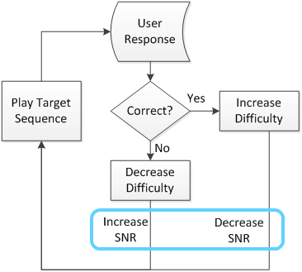
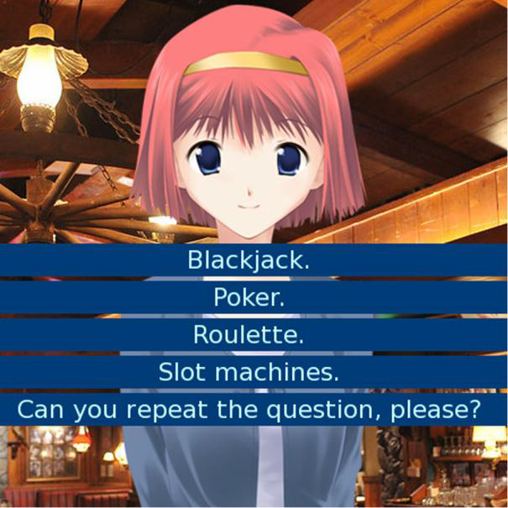
Need & Project Scope
Hearing loss affects 30 million Americans
Treat with hearing aids or cochlear implants
Design a portable controlled noise environment for an auditory training smartphone game to improve usability

Slide 3
Specific Design Requirements
Physical Apparatus
Portable | Lightweight | <0.1 kg in ear (each ear), < 0.5 kg external
 | Compact | Fits in a 20x15x10x cm³ box
 | Intrinsic power source | Supports >90 minutes of use
Usable | Comfortable | 9/10 subjects can wear for > 90 minutes without discomfort.
 | Aesthetics | 9/10 subjects are willing to wear the device in public
Android Smartphone Interface | A/D sampling rate | > 40 kHz
 | Play output signal | > 128 kb/s
 | Control | Signal to noise ratio (SNR) as a double

Slide 4
Specific Design Requirements
Sound Processing
Dynamic |  | <20 ms delay time
Ambient Noise Detection Range |  | 0-75 dBA SPL
Noise Attenuation Range |  | Up to 30 dBA
Frequency range |  | 20Hz – 20 kHz
Output | Speaker signal | Mixed signal with correct SNR, summing training signal and added noise
 | Range | 0-30 dB SPL
 | Frequency | 20 Hz – 20 kHz
 | Maximum | 130 dBA SPL

Slide 5
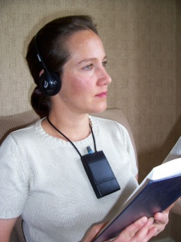
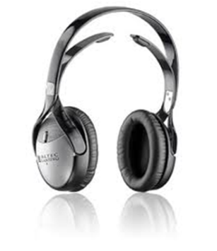
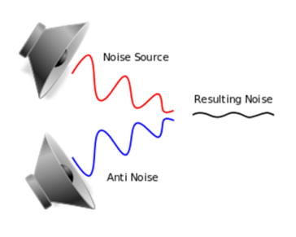
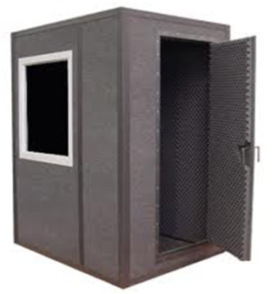
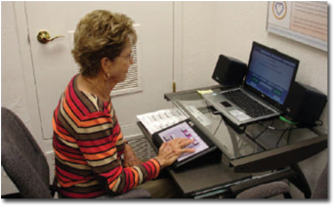
Design Categories
Direct Plug-In
Telecoil stimulation
Headphone
Add-on
Introduce noise
Portability
3D Speaker Array
Noise Cancellation
Sound booth
LACETM
Train at home
SNR Control

Slide 6
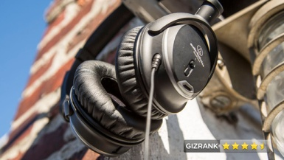
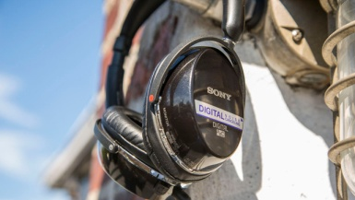
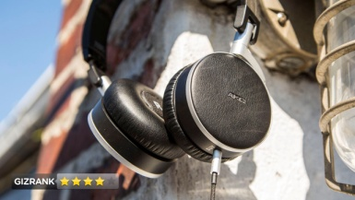
Design Choice – Headphone
 | Weight | Passive, No Speaker | Passive, With Speaker | Active and Passive, No Speaker | Active and Passive, With Speaker
Noise Cancelling Ability | 9 | 4 | 4 | 7 | 7
Ease of Assembly | 7 | 3 | 7 | 3 | 7
Total |  | 57 | 85 | 84 | 112
Notes:
Fix…

Slide 7
Design Modules
Modules
Headphone
External Microphone (9)
Internal Microphone (2)
Apparatus Attachment (8 )
Apparatus body (5)
Smartphone interface
Control algorithm (3)
Design permutations = 2160

Slide 8
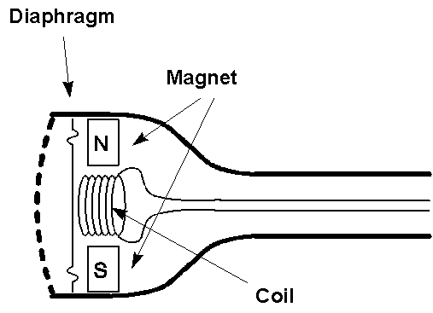
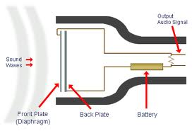
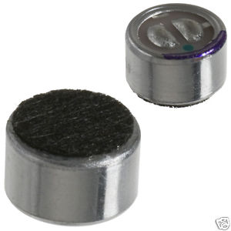
External Microphones
Category
Dynamic
Pros: rugged, long-lasting, less expensive
Cons: frequency distortion
Condenser
Pros: flatter frequency profile, better transient response
Cons: power source, expensive
Directionality
Cardioid
Omni-directional
Placement
Boundary
Stalk

Slide 9
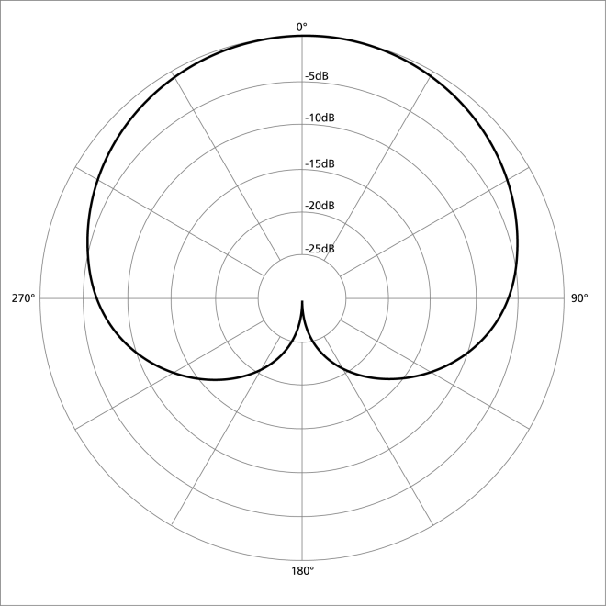
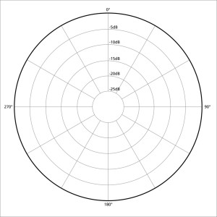
External Microphones
Category
Dynamic
Condenser
Directionality
Cardioid
Pros: resistant to feedback
Cons: proximity effect
Omni-directional
Pros: flatter frequency profile
Cons: feedback
Placement
Boundary
Stalk
Flat

Slide 10
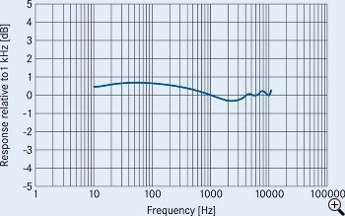
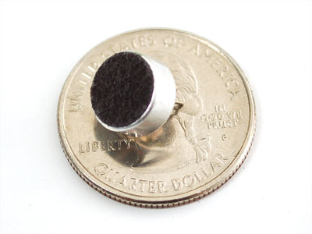
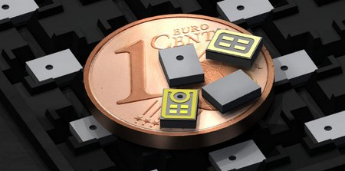
Internal Microphone
Electret
Pros: inexpensive, frequency profile flat
Cons: larger, more inexpensive
MEMS
Pros: very small, EM shielded
Cons: frequency profile mostly flat

Slide 11
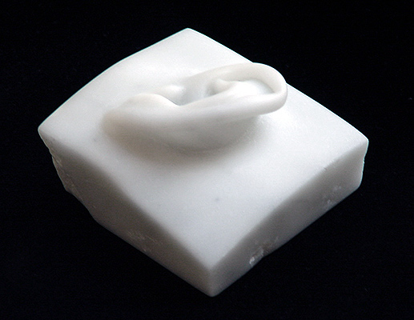
Internal Microphone
Placement
Behind the ear
Behind the earlobe
In external ear canal

Slide 12
Internal Microphone
Placement
Behind the ear
Behind the earlobe
In external ear canal

Slide 13
Internal Microphone
Placement
Behind the ear
In external ear canal
Behind the earlobe

Slide 14
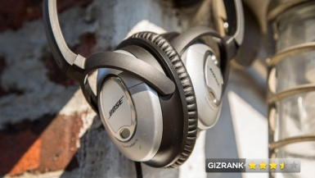
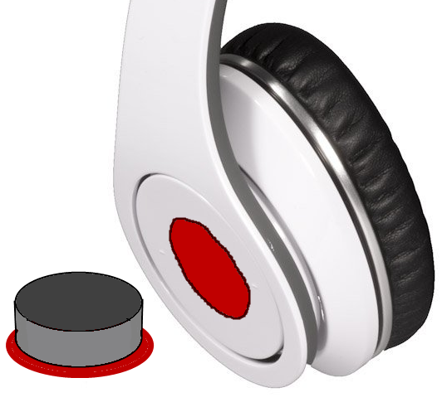
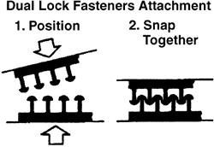
Apparatus Attachment
Clamp
Suction cup
Happeez adhesive
Dual Lock
Screw
Clasp
Snap-button
Glue
Notes:
These solutions have a permanent aspect

Slide 15
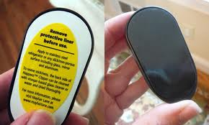
Apparatus Attachment
Clamp
Suction cup
Happeez adhesive
Dual Lock
Screw
Clasp
Snap-button
Glue

Slide 16
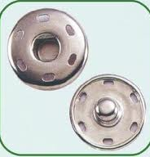
Apparatus Attachment
Clamp
Suction cup
Happeez adhesive
Dual Lock
Screw
Clasp
Snap-button
Glue

Slide 17
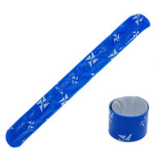
Internal Microphone Attachment
Bistable spring band
Pros: off-the-shelf, storage shape
Cons: difficult, hard to attach
hard to control bending
Telescoping Metal Frame
Flexon
Bent rod
Glue
Magnet

Slide 18
Internal Microphone Attachment
Bistable spring band
Telescoping Metal Frame
Flexon
Pros: flexible, customizable, light, strong
bio-compatible
Cons: proprietary, unavailable
Bent rod
Glue
Magnet

Slide 19
Software
Static Recording
Pros: Absolute SNR control
Cons: Does not account for N_{P}

Slide 20
Software
Static Recording
Iterative
Adjust N_{T} and S
N_{P} calculation
Pros: Calculation has fewer steps (faster)
Cons: Drift in N_{P} may compromise SNR control
SNR for negative feedback
Pros: Precise SNR control
Cons: More calculations increase delay

Slide 21
Design Choice – External Microphone
 | Weight | Dynamic |  |  |  | Condenser
 |  | Cardioid |  | Omnidirectional |  | Cardioid |  | Omnidirectional
 |  | Stalk | Flat | Stalk | Flat | Stalk | Flat | Stalk | Flat | Boundary
Frequency fidelity | 10 | 3 | 2 | 5 | 4 | 8 | 7 | 10 | 9 | 10
Rapid Transient Response | 8 | 8 | 8 | 8 | 8 | 10 | 10 | 10 | 10 | 10
Low Noise | 10 | 10 | 10 | 9 | 9 | 8 | 8 | 7 | 7 | 7
Avoid feedback | 10 | 10 | 10 | 10 | 10 | 6 | 6 | 6 | 6 | 6
Rugged | 7 | 10 | 10 | 10 | 10 | 8 | 8 | 8 | 8 | 7
Low Weight | 5 | 8 | 8 | 8 | 8 | 7 | 7 | 7 | 7 | 5
Size | 6 | 8 | 8 | 8 | 8 | 7 | 7 | 7 | 7 | 3
Aesthetically Acceptable | 5 | 2 | 7 | 2 | 7 | 2 | 7 | 2 | 7 | 6
Total |  | 244 | 259 | 254 | 269 | 285 | 300 | 295 | 310 | 305

Slide 22
Design Choice – Internal Microphone
 | Weight | Electret Condenser | MEMS | Dynamic
EM Shielded | 7 | 7 | 10 | 5
Frequency Fidelity | 10 | 10 | 9 | 5
Small Size | 10 | 6 | 10 | 0
Low Noise | 10 | 7 | 7 | 10
Rugedgness | 5 | 6 | 5 | 10
Sum |  | 309 | 355 | 235

Slide 23
Design Choice – Apparatus Attachment
 | Weight | Bistable | Telescoping | Flexon | Bent Rod | Glue | Magnet
Customizable fit several headphone styles | 3 | 6 | 6 | 8 | 8 | 10 | 10
Comfortable | 7 | 8 | 8 | 8 | 8 | 10 | 10
Non-interfering | 10 | 8 | 8 | 8 | 8 | 0 | 0
Stable/Secure stay > 90 minutes | 10 | 4 | 6 | 10 | 10 | 8 | 8
Available on market | 10 | 10 | 4 | 0 | 6 | 10 | 10
Total |  | 294 | 254 | 260 | 320 | 280 | 280

Slide 24
Design Choice – Internal Microphone Attachment
 | Weight | Clamp | Suction Cup | Happeez Adhesive | Dual Lock | Screw | Clasp | Snap Button | Glue
Reversability | 3 | 10 | 10 | 10 | 8 | 8 | 7 | 8 | 3
Ruggedness | 9 | 8 | 3 | 5 | 8 | 9 | 8 | 7 | 9
Non interfering | 8 | 5 | 10 | 10 | 10 | 10 | 10 | 10 | 10
Comfort | 8 | 5 | 8 | 8 | 8 | 8 | 8 | 8 | 8
Aesthetics | 6 | 4 | 7 | 7 | 7 | 7 | 7 | 7 | 7
Non- destructive | 10 | 3 | 8 | 10 | 10 | 5 | 7 | 6 | 7
Total |  | 236 | 323 | 361 | 382 | 341 | 349 | 333 | 346

Slide 25
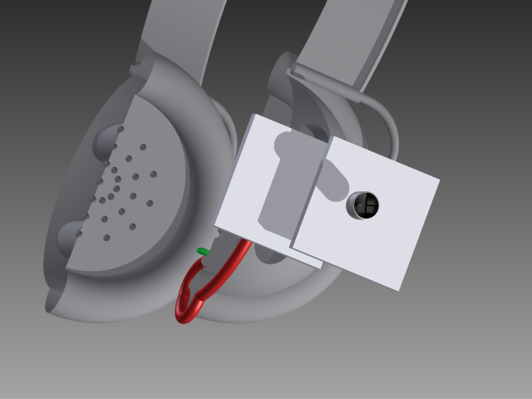
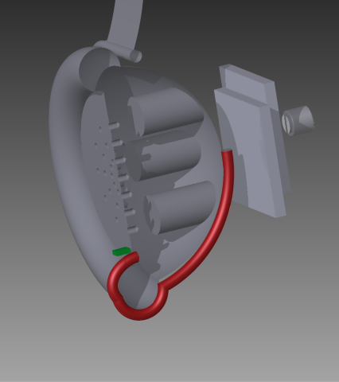
Chosen Design
Headphone: commercial
External microphone: omnidirectional electret (condenser)
Internal microphone: MEMS, positioned behind earlobe
Attachment method: Dual Lock
Bent wire attachment: stainless steel, beryllium, titanium
Smartphone Interface:
Two 3.5 mm port adapter
USB

Slide 26
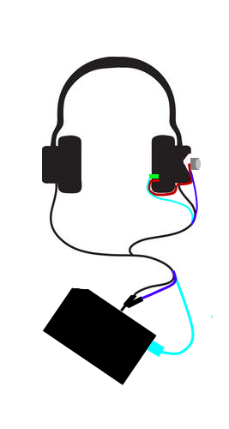
Chosen Design
Headphone: commercial
External microphone: omnidirectional electret (condenser)
Internal microphone: MEMS, positioned behind earlobe
Attachment method: Dual Lock
Bent wire attachment: stainless steel, beryllium, titanium
Smartphone Interface:
Two 3.5 mm port adapter
USB

Slide 27
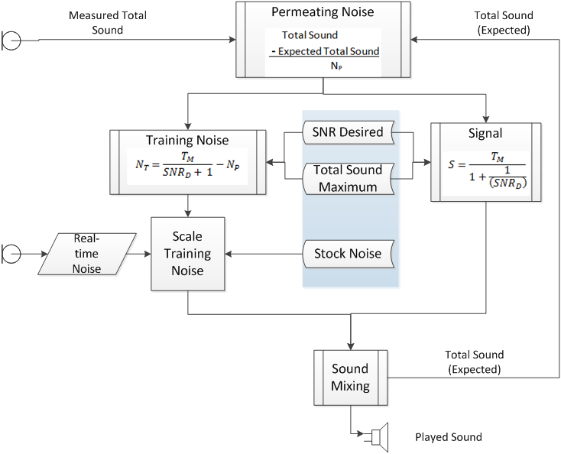
Winner
Internal Microphone
External Microphone

Slide 28
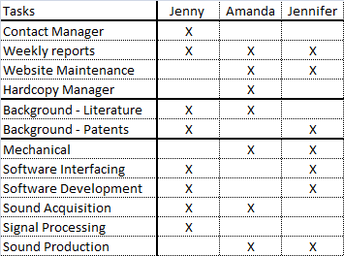
Roles
Tasks | Jenny | Amanda | Jennifer
Contact Manager | X
Weekly reports | X | X | X
Website Maintenance |  | X | X
Hardcopy Manager |  | X
Background - Literature | X | X
Background - Patents | X |  | X
Mechanical |  | X | X
Software Interfacing | X |  | X
Software Development | X |  | X
Sound Acquisition | X | X
Signal Processing | X
Sound Production |  | X | X

Slide 29
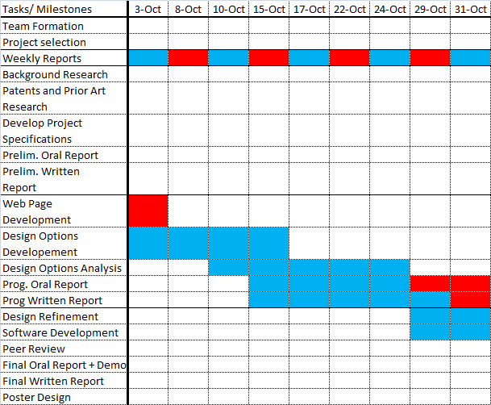
Calendar
 | = due date
 | = working

Slide 30
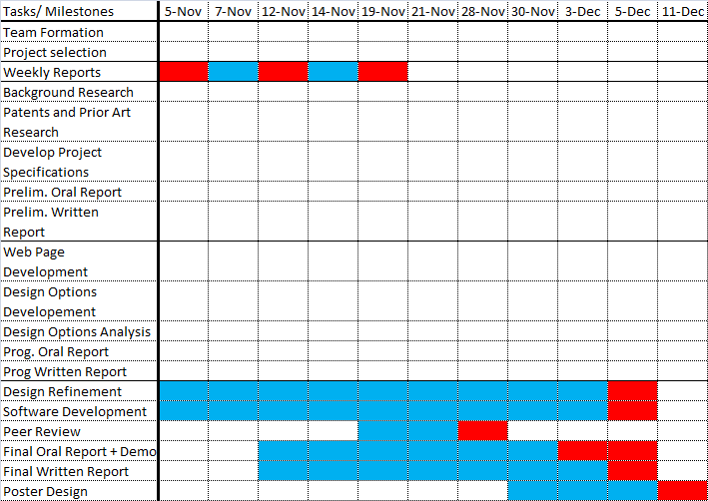
Calendar
 | = due date
 | = working
Tasks/ Milestones | 5-Nov | 7-Nov | 12-Nov | 14-Nov | 19-Nov | 21-Nov | 28-Nov | 30-Nov | 3-Dec | 5-Dec | 11-Dec
Team Formation
Project selection
Weekly Reports
Background Research
Patents and Prior Art Research
Develop Project Specifications
Prelim. Oral Report
Prelim. Written Report
Web Page Development
Design Options Developement
Design Options Analysis
Prog. Oral Report
Prog Written Report
Design Refinement
Software Development
Peer Review
Final Oral Report + Demo
Final Written Report
Poster Design

Slide 31
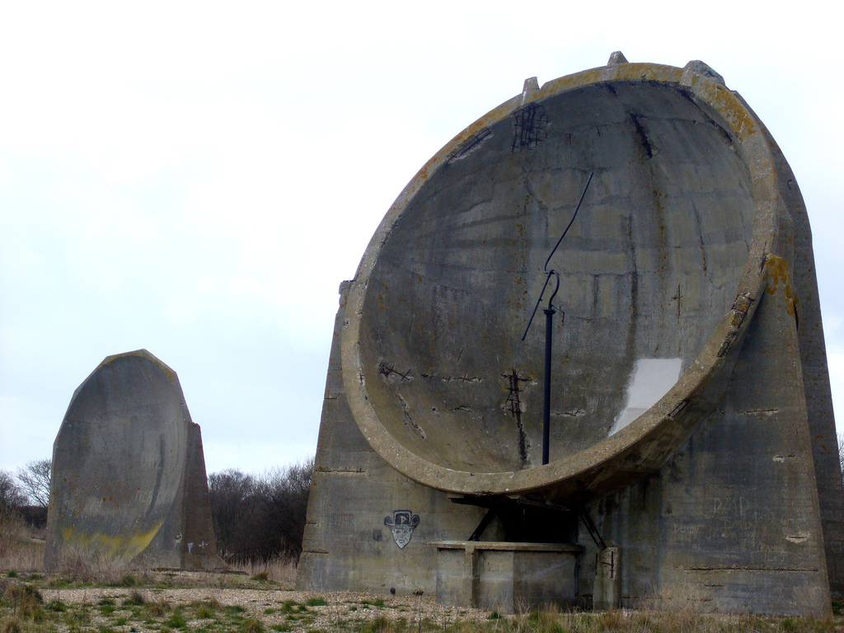
Questions?
WW2 UK Acoustic Mirror (Pre-RADAR)

