Slide 1
Portable Controlled Noise Environment
Team # 34
Jenny Liu
Amanda Spencer
Jennifer Wang
Client
Dr. Dennis Barbour

Slide 2
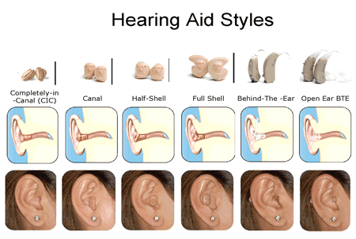
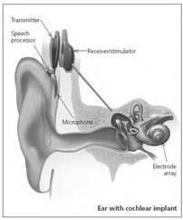
Background – Hearing Loss
Hearing loss affects about 30 million adults¹
Can be treated with hearing aids or cochlear implants
[1] Risk Factors for Hearing Loss in US Adults. Agrawal, Yuri et. al. :2009, Otology & Neurotology, Vol. 30, pp. 139-145
Image Credits: “Types of Hearing Aids”. Canadian Hard of Hearing Society. http://www.chha-nl.nl.ca/hearing-aid-types.html,
Watson, Stephanie. "Hearing Aid Basics" 2007. HowStuffWorks.com. <http://health.howstuffworks.com/medicine/modern-technology/hearing-aid.htm>

Slide 3
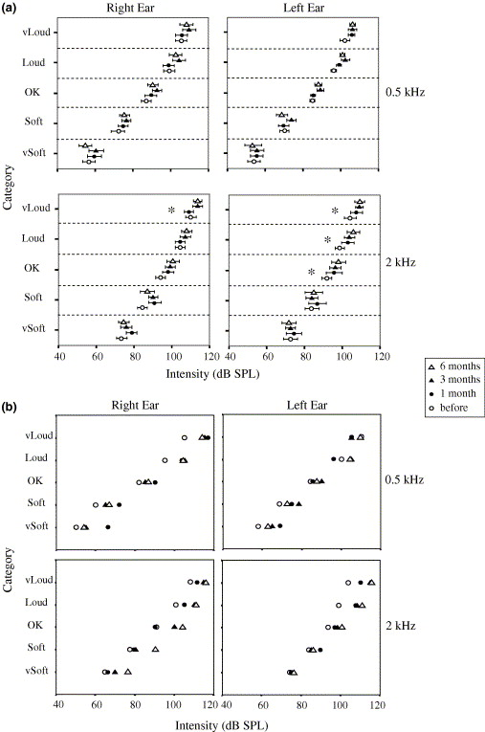
Background – Auditory Training
Auditory training helps improve the efficacy of auditory devices²
Patient compliance is low
Our client is researching a method to engage patients and improve compliance
[2] Olson, Anna D and Canada, Tara B. Using Computerized Auditory Training Clinically for Adults With Cochlear Implants. [Online] American Speech-Language-Hearing Association. http://www.asha.org/aud/articles/auditory-training-adults-cochlear-implants/.
Image Credits: The auditory acclimatization effect in sensorineural hearing-impaired listeners: evidence for functional plasticity. Philibert, B, et al., 2005, Hearing Research, Vol. 205, pp. 131-142

Slide 4
Need and Problem Definition
Need
Increase the usability of the developed auditory training game
Problem Definition
Design a portable controlled noise environment (PCNE)

Slide 5
Scope
The PCNE will consists of a physical apparatus, a noise-processing system, and a speaker
It will deliver the training signal and desired signal to noise ratio from the auditory training regimen to the patient
It will interface with the software developed in Dr. Ledbetter’s project and with any associated hardware
It must be easily used by the average patient

Slide 6
Specifications
Physical Apparatus
Portability | Lightweight | <0.1 kg in ear (each ear), < 0.5 kg external
 | Compact | Fits in a 20x15x10x cm³ box
 | Intrinsic power source | Supports >90 minutes of use
Usability | Comfortable | 9/10 subjects can wear for > 90 minutes without discomfort.
 | Aesthetics | 9/10 subjects are willing to wear the device in public
Smartphone Interface | Record data | >128 kb/s
 | Play training signal | >192 kb/s
 | Control | Take in desired digital signal to noise (SNR) input from an external source

Slide 7
Specifications
Noise Processing
Dynamic |  | <500 ms delay time
Ambient Noise Detection | Range | 0-75 dB
 | Near and far field differentiation | Determine contributions within and beyond 0.5 m within 5% error
Noise Attenuation | Range | 45-65 dB
 | Adjustable | <0.5dB resolution
 | Stable output | <5 dB error
Frequency range |  | 20Hz – 20 kHz
Output |  | Mixed signal comprising of ambient noise, training signal, and artificial noise, at desired SNR
Speaker
Output range | 0-45 dB
Frequency | 20 Hz – 20 kHz

Slide 8
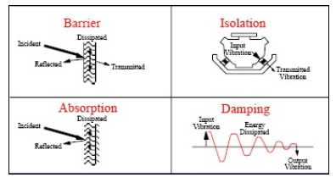
Existing Solutions – Passive Noise Reduction
Mechanically disrupt the transmission of sound energy
Image Credits: Ravindran, A. (2004). Investigation of Inverse Acoustical Characterization of Porous Material Used in Aircraft Noise Control.

Slide 9
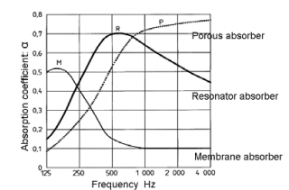
Existing Solutions – Passive Noise Reduction
Mechanically disrupt the transmission of sound energy
Image Credits: Ravindran, A. (2004). Investigation of Inverse Acoustical Characterization of Porous Material Used in Aircraft Noise Control.

Slide 10
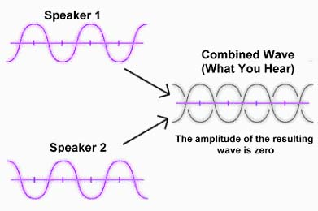
Existing Solutions – Active Noise Reduction
Generate a sound wave exactly out of phase to the original sound
The superposition of the two waves results in destructive interference, and thus silence³
[3] Elliott, S., & P.A., N. (1993). Active Noise Control. IEEEXplore , 10 (4), 12-35.
Image Credits: Stevens, M. (2008, July 18). Toyota to fit Active Noise Cancelling to Crown Hybrid. The Motor Report .

Slide 11
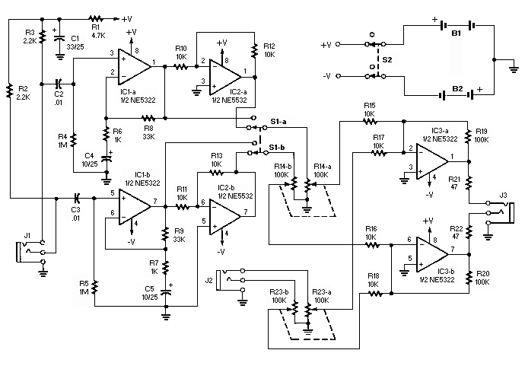
Existing Solutions – Active Noise Reduction
An example signal processing system
Image Credits: J. Ryckebusch, "Build These Noise-Canceling Headphones," HeadWize, 2000. [Online]. Available: http://headwize.com/projects/noise_prj.htm.

Slide 12
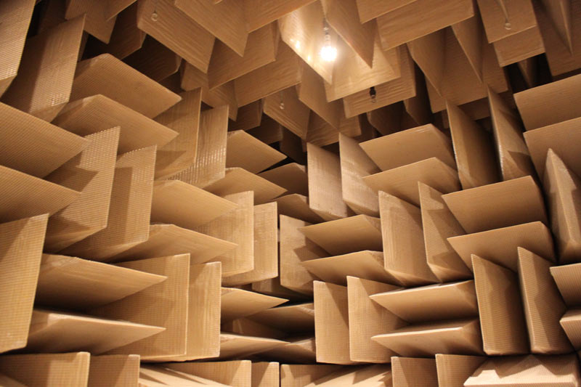
Existing Solutions – Auditory Training
Franks, J. R. Hearing Measurement. World Health Organization.
Soundproofed rooms⁴
Quiet area of house⁵
[4] World Health Organization, "Occupational Exposure to Noise: Evaluation, Prevention and Control," 2001. [Online]. Available: http://www.who.int/occupational_health/publications/occupnoise/en/index.html.
[5] Neurotone, "LACE 4 Auditory Training Manual for the Hearing Health Care Professional," 2007-2010.
Image Credit: Rothman, W. (2009, October 1). Microsoft’s Anechoic Chamber: The Place Where Sound Goes To Die.

Slide 13
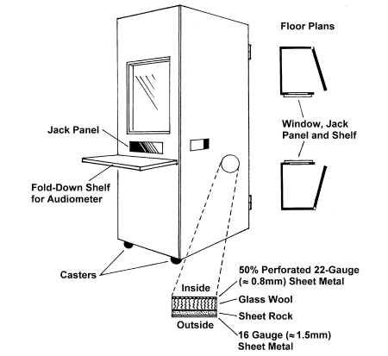
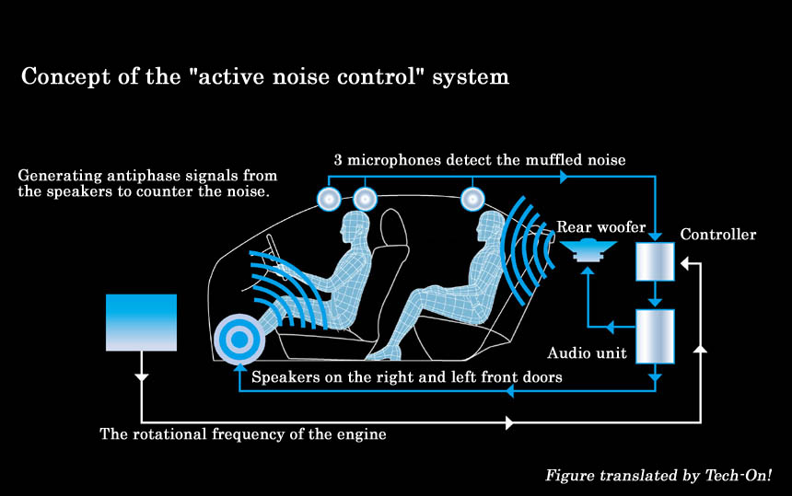
Existing Solutions – Other Noise Reducing Technology
Noise reduction in small enclosures^{6,7,8}
[6] Franks, J. R. Hearing Measurement. World Health Organization.
[7] Ogawa, K. (2008, June 20). Toyota Cuts 'Muffled Noise' in Crown Hybrid. (Nikkei Automotive Technology)
[8] Theobald, M. A., & Hammelef, D. M. (2011). Patent No. 8045725. United States of America.

Slide 14
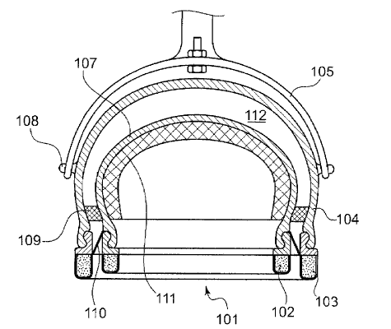
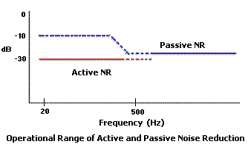
Existing Solutions – Other Noise Reducing Technology
Passive Noise Reducing Headphones⁹
Active Noise Reducing Headphones^{10,11}
[9] Du, Y., Homma, K., & Vaudrey, M. A. (2010). Patent No. 7703572. United States of America
[10] C. Moy, "Active Noise Reduction Headphone Systems," HeadWize, 2001. [Online]. Available: http://gilmore2.chem.northwestern.edu/tech/anr_tech.htm.
[11] W. Harris, "How Noise-canceling Headphones Work," HowStuffWorks, 15 February 2007. [Online]. Available: http://electronics.howstuffworks.com/gadgets/audio-music/noise-canceling-headphone3.htm.

Slide 15
Preliminary Design Schedual
Tasks/ Milestones | 29-Aug | 3-Sep | 5-Sep | 10-Sep | 12-Sep | 17-Sep | 19-Sep | 24-Sep | 26-Sep | 1-Oct | 3-Oct | 8-Oct | 10-Oct | 15-Oct | 17-Oct
Team Formation
Project selection
Weekly Reports
Background Research
Patents and Prior Art Research
Develop Project Specifications
Prelim. Oral Report
Prelim. Written Report
Web Page Development
Design Options Development
Design Options Analysis
Prog. Oral Report
Prog . Written Report
Design Refinement
Peer Review
Final Oral Report
Final Written Report
Poster Design

Slide 16
Preliminary Design Schedual
Tasks/ Milestones | 22-Oct | 24-Oct | 29-Oct | 31-Oct | 5-Nov | 7-Nov | 12-Nov | 14-Nov | 19-Nov | 21-Nov | 28-Nov | 30-Nov | 3-Dec | 5-Dec | 11-Dec
Team Formation
Project selection
Weekly Reports
Background Research
Patents and Prior Art Research
Develop Project Specifications
Prelim. Oral Report
Prelim. Written Report
Web Page Development
Design Options Development
Design Options Analysis
Prog. Oral Report
Prog. Written Report
Design Refinement
Peer Review
Final Oral Report
Final Written Report
Poster Design

Slide 17
Team Organization
Tasks | Jenny | Amanda | Jennifer
Contact Manager | X
Weekly reports | X | X | X
Website Maintenance |  | X | X
Hardcopy Manager |  | X
Literature | X | X
Patents | X |  | X
Mechanical |  | X | X
Software Interfacing | X |  | X
Sound Acquisition | X | X
Signal Processing | X
Sound Production |  | X | X

Slide 18
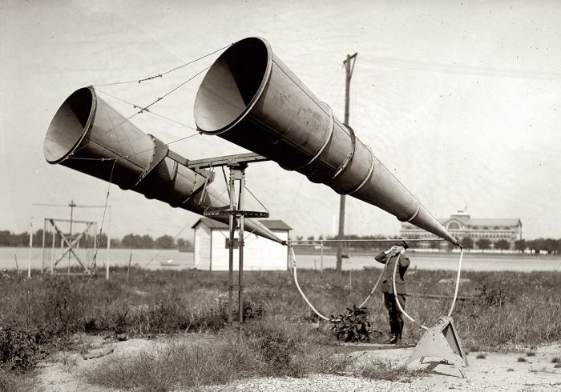
Questions?
Image Credit: Chris, Wild. "Pre-radar listening devices, c. 1900-1945."Retronaut. <http://www.retronaut.co/2011/07/listening-before-radar/>.

