Slide 1
Portable Controlled-Noise Environment
Amanda Spencer, Jenny Liu, Jennifer Wang
Team 34
Final
Notes:
Good morning. My name is Amanda Spencer, and I am representing team 34. Our project is the portable controlled-noise environment.

Slide 2

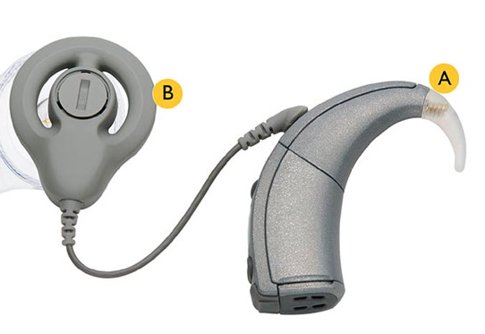
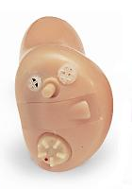
Need
12.5 million people have hearing devices in U.S.
Standard auditory training compliance very low
Improve compliance with new format
Notes:
12.5 million people in the U.S. have hearing devices at this time. These devices improve hearing, but auditory training is necessary to take full advantage of their potential. Unfortunately, compliance with traditional forms of auditory training is very low. A new format is being designed to be more interesting and convenient in hopes of improving compliance rates. Part of that convenience relies on the ability to make the noise-controlled environment portable.

Slide 3

Design Requirements
Interfaces with Android smartphone
Permeating noise calculated in real time
Environment with controlled SNR
Notes:
We had a number of requirements, but it basically boils down to these three; it must interface with the Android smartphone, and the permeating noise must be measured in real time to enable precise control over the SNR within the environment.

Slide 4
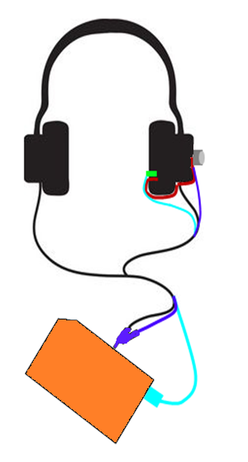
Chosen Design
Adapt to user’s headphones
External microphone
Internal microphone
Bent rod attachment
Smartphone interface
Splitter → headphones and external microphone
USB connecter → internal microphone
Notes:
I will briefly review the design we chose. We decided to attach the device to the user’s own headphones. It is difficult to find a headphone that comfortably fits one person’s ear shape, much less one that is equally comfortable for 100 different people. The external microphone, which sits on an A-weighted filter, is used to generate realistic noise, and the internal microphone is used to calculate the permeating noise. The internal microphone is attached to the headphone via a bent rod connected to the outside of the earmuff. As mentioned earlier, the device must interact with a smartphone. To do this, the headphones and external microphone are attached to the audio jack via a splitter and the internal microphone is plugged in using a USB connector.

Slide 5
Chosen Design
Adapt to user’s headphones
External microphone
Internal microphone
Bent rod attachment
Smartphone interface
Splitter → headphones and external microphone
USB connecter → internal microphone

Slide 6
Chosen Design
Adapt to user’s headphones
External microphone
Internal microphone
Bent rod attachment
Smartphone interface
Splitter → headphones and external microphone
USB connecter → internal microphone

Slide 7
Chosen Design
Adapt to user’s headphones
External microphone
Internal microphone
Bent rod attachment
Smartphone interface
Splitter → headphones and external microphone
USB connecter → internal microphone

Slide 8
Chosen Design
Adapt to user’s headphones
External microphone
Internal microphone
Bent rod attachment
Smartphone interface
Splitter → headphones and external microphone
USB connecter → internal microphone

Slide 9
Chosen Design
Adapt to user’s headphones
External microphone
Internal microphone
Bent rod attachment
Smartphone interface
Splitter → headphones and external microphone
USB connecter → internal microphone

Slide 10
Chosen Design
Adapt to user’s headphones
External microphone
Internal microphone
Bent rod attachment
Smartphone interface
Splitter → headphones and external microphone
USB connecter → internal microphone

Slide 11
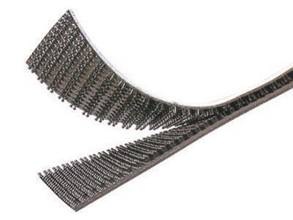
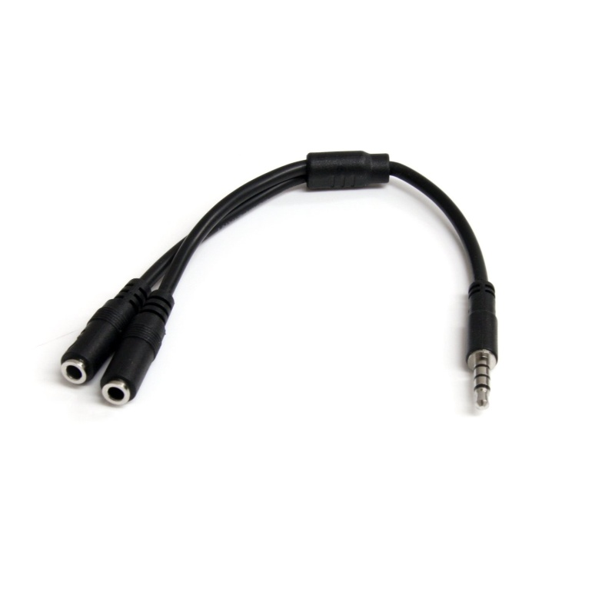
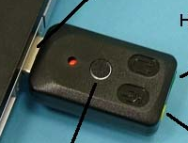
Mechanical
Bent rod
Splitter
USB connecter
Dual Lock adhesive
Notes:
Our discussion can be effectively divided into three categories: mechanical, electrical, and software. The mechanical portion consists of the bent rod, the splitter, the USB connector, and the dual lock adhesive which allows the reversible attachment of the device to the headphones.

Slide 12
Mechanical - Analysis
Bent Rod Requirements
  Rigid
  Springs back to original shape
  Thin
Notes:
The bent rod must be rigid enough to hold the internal microphone relatively stable. If force is placed on the rod during attachment or detachment, it should be able to spring back to its original shape. However, we want it as thin as possible to minimize the interruption of the sound seal and to avoid discomfort. The best solution is to make the core out of some sort of metal. This frame provides structure for the wires, but what’s to keep them from sliding off? To this end, we decided to add a tightly-fitting cover around both wires and core. We can also use this material to ensure that the device is hypoallergenic.

Slide 13
Mechanical - Analysis
Bent Rod Requirements
  Rigid
  Springs back to original shape
  Thin

Slide 14
Mechanical - Analysis
Bent Rod Requirements
  Rigid
  Springs back to original shape
  Thin

Slide 15
Mechanical - Analysis
Bent Rod Requirements
  Rigid
  Springs back to original shape
  Thin
  Wires secured to frame

Slide 16
Mechanical - Analysis
Bent Rod Requirements
  Rigid
  Springs back to original shape
  Thin
  Wires secured to frame

Slide 17
Mechanical - Analysis
Bent Rod Requirements
  Rigid
  Springs back to original shape
  Thin
  Wires secured to frame
  Hypoallergenic

Slide 18
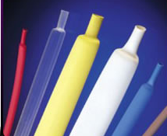
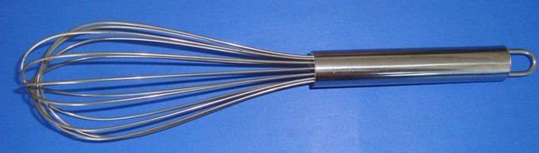
Mechanical - Analysis
Core
  Type 304 Stainless Steel
Covering
  polyolefin heat shrinkable tubing
Notes:
For the core, we initially considered metals typically used in glasses frames, since the requirements are similar: stiffness, thinness, biocompatibility. We ended up choosing stainless steel for its workability and cost effectiveness. Of the types of stainless steel, the 300 series is the most ductile, and 304 in particular has good spring-back. It is commonly used in cooking utensils.
To get a snug fit for the covering, we decided to use heat shrink. Of those available, polyolefin was the cheapest option that was both hypoallergenic and low friction.

Slide 19
Mechanical - Analysis
Calculations
Notes:
Type 304 stainless steel can be deformed up to 1° and still spring back to its original form. We estimated the maximum likely force to be about 5 lbs, and we used that to calculate the required diameter of the core. We took advantage of these mechanical equations and plotted degree of deformation under 5 lb force as a function of radius. Drawing a line across at 1°, we find the required diameter to be 3.26 mm.

Slide 20



Mechanical - Analysis
Calculations

Slide 21
Mechanical - Analysis
Calculations

Slide 22
Mechanical - Analysis
Calculations
  Necessary diameter: 3.26 mm

Slide 23

Mechanical - Details
Core
  Type 304 Stainless Steel Rod
    4 mm diameter, 1 m length
    McMaster-Carr (1272T13)
    $6.45 ea, 1 day lead time
Covering
  Flexible Polyolefin Heat-Shrink Tubing
    1/8” diameter after shrinking, 4 ft long
    McMaster-Carr (7856K151)
    $2.81 ea, 1 day lead time
Notes:
Of course, stainless steel rods don’t come in such odd sizes. The closest we could find was 4mm diameter. The heat-shrink tubing, which has a shrink ratio of 2:1, must have a final diameter marginally smaller than the diameter of the core to ensure a snug fit, so we chose the 1/8”. Both materials were available through McMaster-Carr.

Slide 24
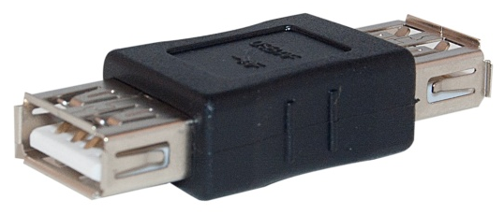
Mechanical - Details
USB connector
  USB Microphone
    Planet Headset(USB mic 1)
    $59 ea, 3 day lead time ($12.95)
  Female-Female USB Coupler
    Cable Wholesale (30U1-02400)
    $.92 ea, 3 day lead time ($ 12.20)
Notes:
As discussed in our last presentation, the internal microphone can be attached to the smartphone by wiring it to the jack in a USB microphone which is in turn attached via the coupler to the USB extension of the phone.

Slide 25
Mechanical - Details
Splitter
  3.5mm Headset Splitter Adapter
    20 cm length, 9 g weight
    StarTech.com (MUYHSMFF)
    $10.99 ea, 2 day lead time ($21.06)
Dual Lock
  Indoor-Outdoor Dual Lock
    1” wide
    3M (SJ3870)
    $12.47/yd
Notes:
The splitter adapter allows the simultaneous support of a microphone and a headphone. To secure the device, one side of the dual lock is mounted on the box holding the PCB board and the other is attached to the outside of the earmuff.

Slide 26
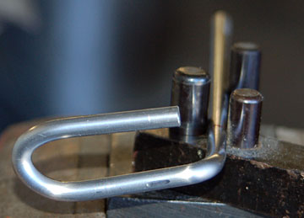
Mechanical - Manufacturing
Rod Bending
  ~10 minutes per frame
  $52/hour
Notes:
Each frame core must be cut down to size before placing the 3 90° bends. This work can be done in the school machine shop, which charges $52 per hour. We estimate a time of 10 minutes per frame.

Slide 27
Mechanical - Manufacturing
Part | Qty. | Unit Price | Subtotal | Shipping | Total
Rod | 12 | $6.45 | $77.40 | $0 | $77.40
Covering | 9 | $2.81 | $25.29 | $0 | $25.29
Splitter | 100 | $10.99 | $1099 | $21.06 | $1120.09
Adapter | 100 | $59 | $5900 | $12.95 | $5912.95
USB Mic | 100 | $.92 | $92 | $12.20 | $104.20
Dual Lock | 9 yrds | $12.47 | $112.23 | $0 | $112.23
Box | 100 | $3.49 | $349 | $0 | $349
Processing | 16.67 hrs | $52 | $866.67 | --------- | $333.33
Total |  |  |  |  | $8568.13
Unit Cost: $85.68
Notes:
Adding up the costs of the parts, shipping, and processing, the mechanical portion of the design comes out to be $85.68 per unit. We’ll add the electrical costs presently.

Slide 28
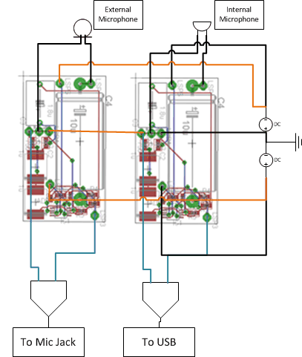
Electrical
Internal microphone
External microphone
A-weighted filter
Batteries
Notes:
The electrical category consists of the internal microphone, the external microphone, the A-weighted filter, and the batteries. To the right, you see the circuit schematic connecting these parts.

Slide 29
Electrical - Analysis
A-weighted filter
Notes:
This is a circuit diagram of the A-weighted filter. A-weighting mimics the way the ear processes sound with greatest sensitivity between 1 and 4 kHz.

Slide 30
Electrical - Analysis
A-weighted filter
Notes:
This shows the magnitude response of the circuit on top of the ideal A-weighting magnitude profile. As you can see, the circuit is very consistent with what it should be. The right graph shows the phase response, which is relatively linear until 1kHz, at which point some distortion may be introduced.

Slide 31
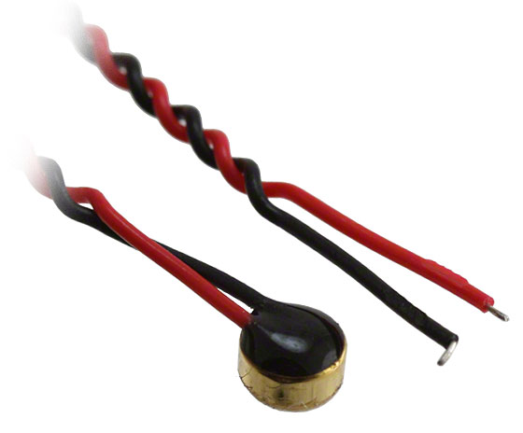
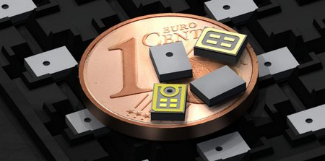
Electrical - Analysis
Internal Microphone
  MP34DT01TR surface-mounting MEMS microphone
External Microphone
  CME-1538-100LB electret microphone
Notes:
The internal microphone was chosen because it was surface-mounted and covered the entire frequency range from 20Hz-20kHz. The external microphone was chosen because it covered the range, had the smallest footprint, and was waterproof, which is important since it will be exposed to the elements.

Slide 32



Electrical - Analysis
Electret
  Sensitivity: -38±3 dB
  Maximum sound: N/A
MEMS
  Sensitivity: -26±3 dB
  Maximum sound: 120 dB SPL
94 dB SPL
97 dB peak
120 dB peak
Notes:
The maximum allowed input voltage of the circuit is 5.4 V p-p. To ensure the microphone falls within that range, we used the sensitivity and maximum sound to calculate the maximum input voltage. The maximum input voltage is 2 V p-p which falls well within the allowable range.

Slide 33
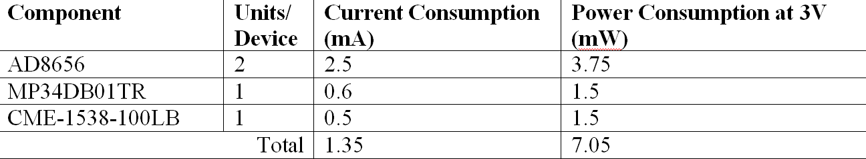
Electrical - Analysis
Power Considerations
  Duracell 3 V 180 MAH coin battery
Notes:
The power considerations are summarized in this table. To power the device, we chose to use two Duracell 3 V coin batteries. These batteries will last for 133 90-minute sessions. This allows more than two training sessions a week for an entire year.

Slide 34
Electrical - Details
Internal Microphone
  MP34DT01TR MEMS Microphone
    4mm x 3mm x 1.1mm
    20Hz-20kHz
    Digi-Key (497-12016-1-ND)
External Microphone
  CME-1538-100LB Electret Condenser Microphone
    4mm d, 2.9mm h
    20Hz-20kHz
    Digi-Key(102-2190-ND)
Notes:
Here are some of the details of the chosen microphones. Both the MEMS microphone and the electret microphone were available through Digi-Key

Slide 35
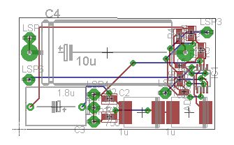
Electrical - Details
PCB Board
Notes:
This shows the layout of the PCB board for the A-weighted filter. The dimensions of the board ended up being 1.6”x.9”.

Slide 36
Electrical - Manufacturing
Part | Price | Unit Price | Lead Time
Printing | $2034 | $20.34 | 7 days
Assembly | $3362 | $33.62 | 10 days
Components | $1244 | $12.44 | 12 weeks
Op Amp | $463.36 | $4.63 | 3 days
Electret mic | $284 | $2.84 | 3 days
MEMS mic | $300 | $3.00 | 3 days
Shipping | $38.14 | $0.38 | ------------
Total | $7725.50 | $77.26 | ------------
Total Unit Cost: $77.26 + $85.68 = $162.94
Notes:
The electrical components come out to be $77.26 per unit, combined with the mechanical costs, the total cost per device is $162.94.

Slide 37
Weight
Part | Amt. | Wt./Amt. | Weight
Rod | 1.28 cc | 8.03 g/cc | 10.25 g
Covering | 1.16 cc | .9 g/cc | 1.04 g
Splitter | ---------- | ------------- | 9 g
Adapter | ---------- | ------------- | 9 g
USB Mic | ---------- | ------------- | 45 g
Box | ---------- | ------------- | 1 g
Dual Lock | 3 in² | .9 g/in² | 2.7 g
Board | ----------- | ------------- | 16 g
Unit Weight: 94 g
Head Weight: 31 g
Notes:
The overall weight, 94 g, is not excessive in comparison to the smartphone, which generally runs between 100 and 200 g. The potential concern would be imbalance caused by adding weight to only one side of the head. Fortunately, 31 g is significantly less than the standard headphone weight of about 400 g.

Slide 38
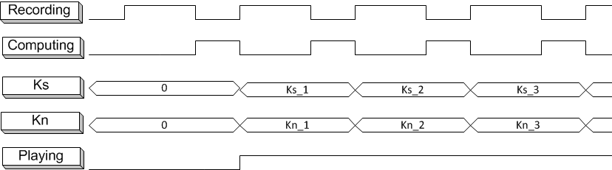
Software - Analysis
Run Time
  Sound player: 26.85 ms
    Loading sound file and preparing to play it
CPU Requirements
  22% CPU usage
Timing
Notes:
In the program, loading the sound file and preparing to play it takes 26.85 ms. When the software is running, it makes use of 22% of the CPU. The timing diagram shows how the recording and computing alternate. The playing begins after the first computation, and the two K values change after each subsequent computation.

Slide 39
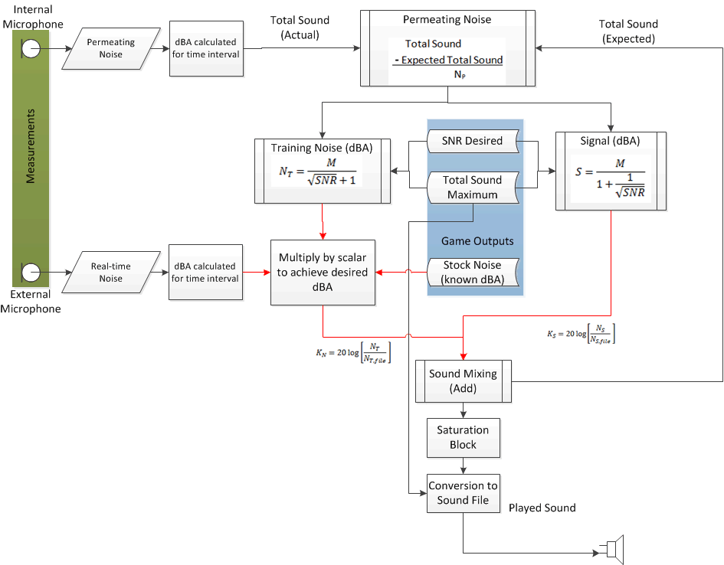
Software - Details
Algorithm/ Flow Diagram
Notes:
This is the algorithm for generating the sound signal as implemented through the software.

Slide 40

Software - Details
Software Package
  Target Version: Android 4.1.2 (API 16)
  Lowest Version: Android 2.2 (API 8)
Hardware Requirements:
  Sound Card
  Audio Jack
  USB jack
Notes:
The target version of Android is Android 4.1.2 which was the most recent version of Android we were aware of when we started programming. The lowest version of Android that the application will support is Android 2.2, which came out two years ago. We thought this was safe since the average cellphone contract lasts 2 years.
In order to implement the program, the smartphone must have a sound card, an audio jack, and a USB jack to support the necessary inputs.

Slide 41
Software - Demonstration
SNR = 24 dB
#1
#2
SNR = 1 dB
#3
#4

Slide 42
Safety Analysis
High Risk
  Sound levels exceeding 130 dB
  Electrical exposure to water
Moderate Risk
  Injury due to sharp edges
  Allergic reaction to rod
Notes:
Our device isn’t much more dangerous than your typical smartphone app, but there are some safety factors involved, the highlights of which are shown behind me. The greatest risk by far is potential hearing damage if the sound levels exceed 130 dB. To counteract this issue, we placed a cap in the software that prevents the output sound from exceeding 130 dB. Also significant is the potential damage due to water exposure. Because headphones are exposed to the elements, we decided to shield the electrical components we could by placing them within a plastic box. This also helps lessen the risk of injury due to sharp edges of the circuit board during attachment and detachment. Another moderate risk is allergic reaction where the device contacts skin, but it is unlikely now that we used the hypoallergenic polyolefin to wrap the rod.

Slide 43
Conclusion
Problem Analysis
Notes:
Though some of the specific design requirements were adapted as the project progressed, we did solve the problem. The recording from the internal microphone is used to find permeating noise which informs the program how much extra noise need be introduced to reach the desired SNR. We learned a lot during the project and improved many of our technical skills, CAD modeling and Android development to name a few. On an interpersonal level, our communication and client interaction skills were exercised as well. If we were to do this project over again, we would try to nail down the scope more clearly from the beginning and make better use of teachers from other departments.
Because the device isn’t terribly dangerous, the main ethical consideration is whether this method of audio training is superior to the traditional method. It gives a degree of independence, but at the same time, the researcher loses the ability to monitor and correct the patient’s technique. The addition of mobility introduces a new risk factor: lack of attention to the outside world. It may not be quite as dangerous as texting while driving, but becoming absorbed in the training while walking in traffic could prove dangerous, compounded by the fact that the headphones affectively block out any warning signals that might prevent such an accident.

Slide 44
Conclusion
Problem Analysis
Ethical Considerations

Slide 45
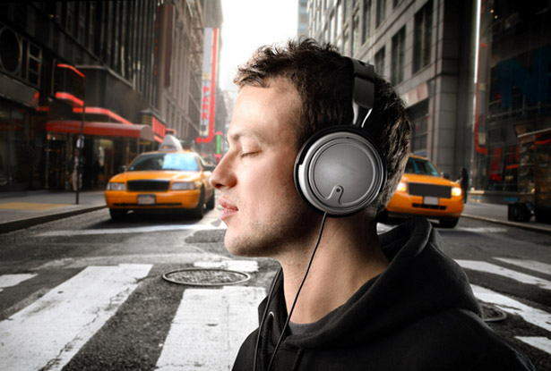
Conclusion
Problem Analysis
Ethical Considerations

Slide 46
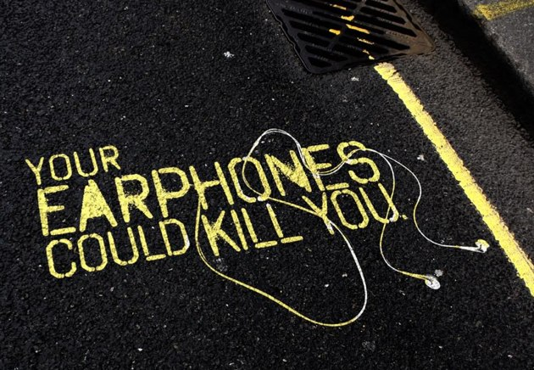
Conclusion
Problem Analysis
Ethical Considerations

Slide 47
Conclusion
Intellectual Property
Future Directions
Notes:
Our design could be considered intellectual property. The combination and interplay of the different parts are non-obvious and unique from any current products. There are no devices that allow SNR adjustment while simultaneously accounting for permeating noise.
The next step in our project would be to pass the external noise in real time. This would benefit both patients and the average headphone user, since it would allow increased environment awareness and would hopefully prevent such accidents as just mentioned.

Slide 48
Questions?

